Slide 1
Lending Club Case Study
ML-AI C50
UpGrad Executive PG for Machine Learning and AI

Slide 2
Overview
Lending Club is a lending platform that helps customers lend money at an interest rate based on banking standards.
This case study is to gain knowledge on understanding the risk analytics in banking and financial services and how data can be used to minimise the risk of losing money while lending to the customers.

Slide 3
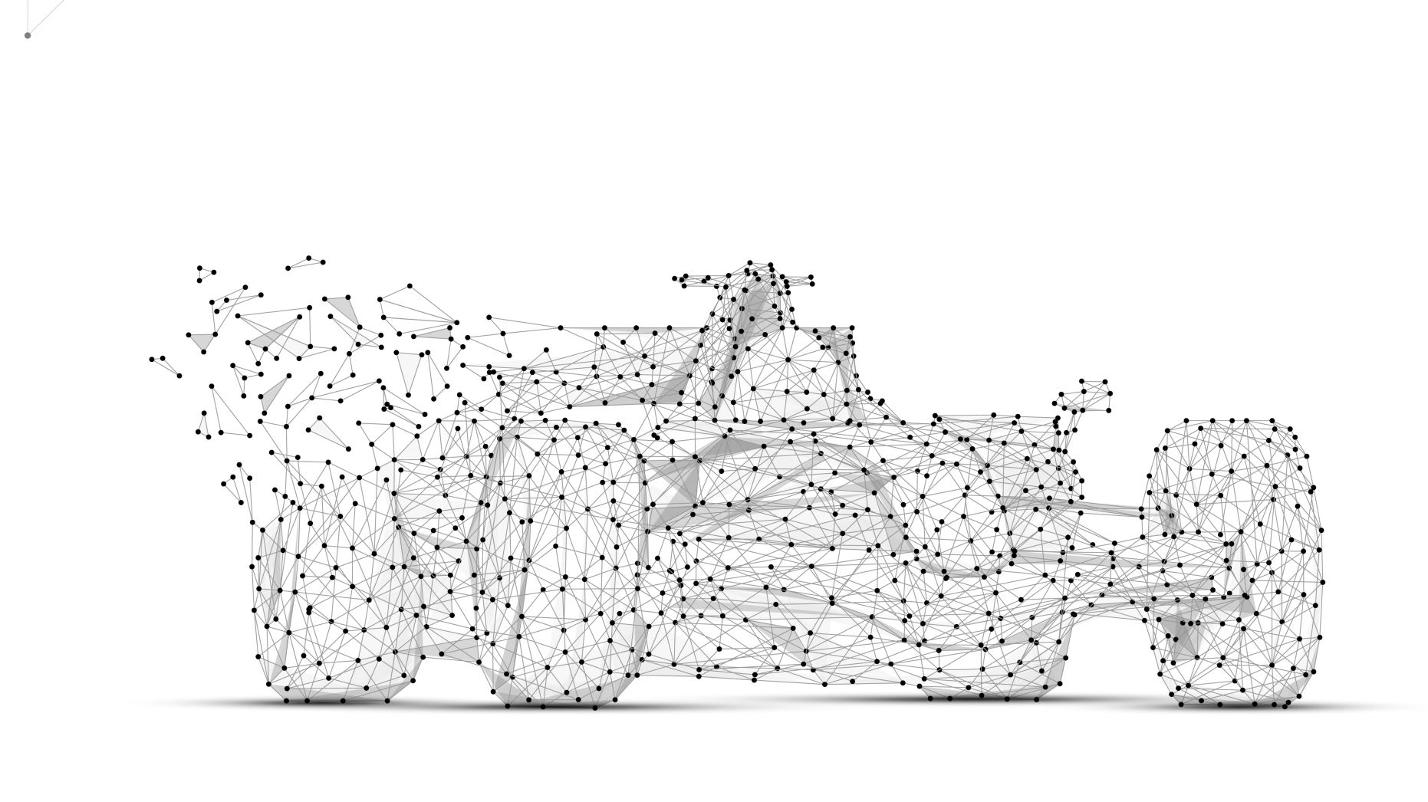
Aim
Analysing the past lending data, the company wants to understand the driving factors (or driver variables) behind loan default, i.e., the variables which are strong indicators of default. The company can utilise this knowledge for its portfolio and risk assessment. a.k.a, Identify the key factors that will help identify a potential defaulter.

Slide 4

About Us
S K Vasista Eranki
A Full-stack developer with 12+ years of experience, currently working on automating deployments and maintenance on Azure Cloud. Experience on product development for MSCM domain, and cloud infrastructure and configuration management tools.
Gautham Singh
Back-End Engineer with 5+ years of experience developing and maintaining scalable, high-performance, and secure server-side applications. Experience in various domains like Health, FMCG, Real Estate, and Social Media platforms.

Slide 5

Initial Analysis
The Data contains 38717 Records and 111 rows which correspond to a Loan Data set, which has loans catered to different purposes.
~50% of the data has null values or columns with only 1 value. These columns may not be useful for the analysis.
The Data Column ‘loan_status’ attributes the Status of the Loan. The value ‘Charged Off’ means its defaulted. This column is required to filter out the defaulted data and perform analysis.
The Data has few demographic information which can be made use of.
The data has many columns that correspond to the current on-going loan information (such as outstanding principal amount etc..)
The Data has information about some of the codes that are determined by the Grade and Sub-Grade. These can be considered as a Lending Club’s categorization of loans. A specific analysis based on this can give insightful results.

Slide 6
Steps
Data Cleaning
Discarding unwanted Data
Filling in Missing Values in the Data
Data Conversions & Extraction
Converting the columns that have Numeric Data
Converting the columns that represent DateTime
Extract Month, Year from the required Date Time columns
Discard Data containing the Outliers as it may impact the current analysis
Data Analysis
Univariate Analysis on the data
Bivariate Analysis on the data
Binning Continuous Data to identify Patterns
Comparing various Data
Filtering Outliers Data

Slide 7
Data Cleaning

